Slide 1
Innovation
Personal and Organizational
“No problem can be solved within the same set of assumptions that created it.”
Albert Einstein
Presented by Bob Walters

Slide 2
Innovation & Leadership are Linked
Most organizations have a few defining challenges that, if solved in new ways, would transform the business
This transformation is the outcome of leaders changing how they think and act
Leaders change when there is a compelling reason for doing so; this requires transformative goals
Transformative Goals change the game by forcing new insight
Insight results from new experiences supported by reflection, coaching and reapplication
HBR January 2014

Slide 3
The Innovation Equation
Creativity
Process Excellence
Business Acumen
Functional Innovation
×
×
(f)I=C×PE²×BA³
Adapted from McCartland and Christienson

Slide 4
Innovation & Financial Performance
“The greater the amount of innovation, the greater the market and financial performance”
Soo, Devinney, Midgley & Deering (2002)
¹Performance in % Points (using Bottom 20% as benchmark)
Notes:
More than 317 firms responded to a survey put out by the authors. What they found was that when the companies were broken into fifths based on innovation, and then compared against their competition. The one-fifth most innovative showed clear superiority with respect to financial performance. Particularly in regard to market share, which was 35% higher than the bottom one-fifth - which was used as the bench mark..

Slide 5
Organizations Innovate Differently
 | Creativity | Process Excellence | Business Model
Computing | Apple | Lenovo | Microsoft
Automotive | Nissan | Toyota | Hyundai
Pharma | Amgen | Sanofi- Pasteur | Covance
Philanthropy | Gates | Red Cross | Gameen Bank
…how do you innovate?

Slide 6
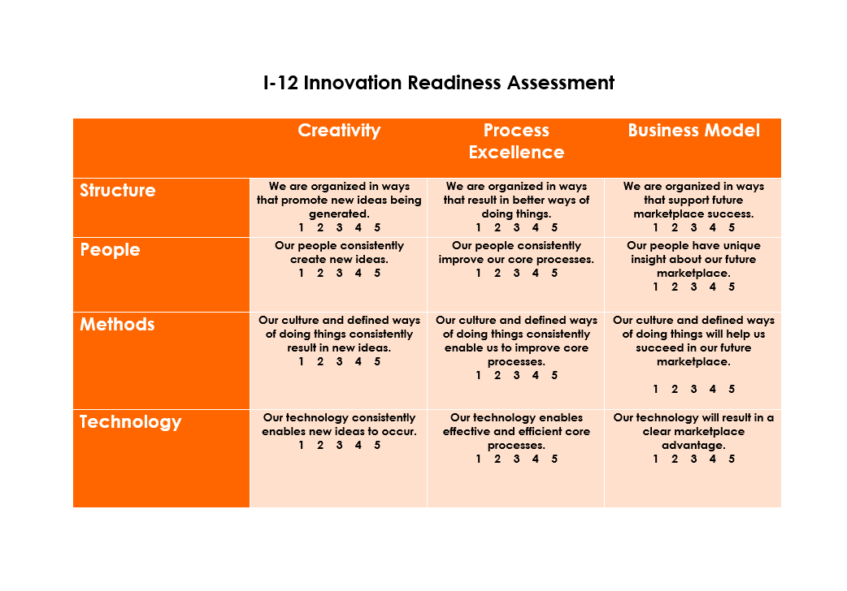
Innovation Readiness

Slide 7
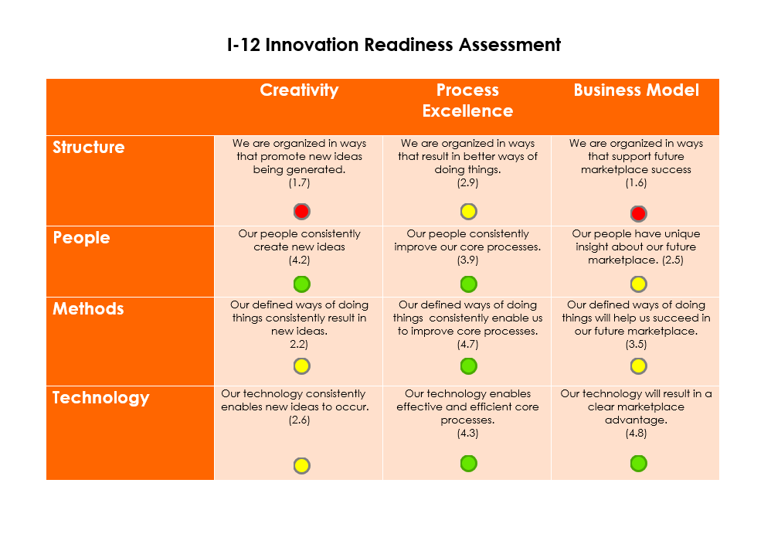
How Ready for Innovation Are We?

Slide 8
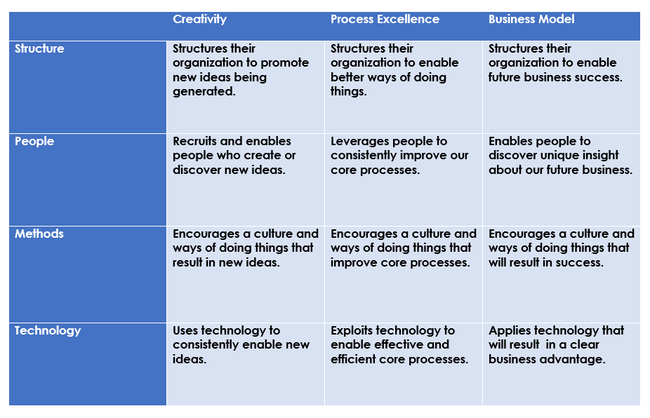
Leadership Readiness Assessment

Slide 9
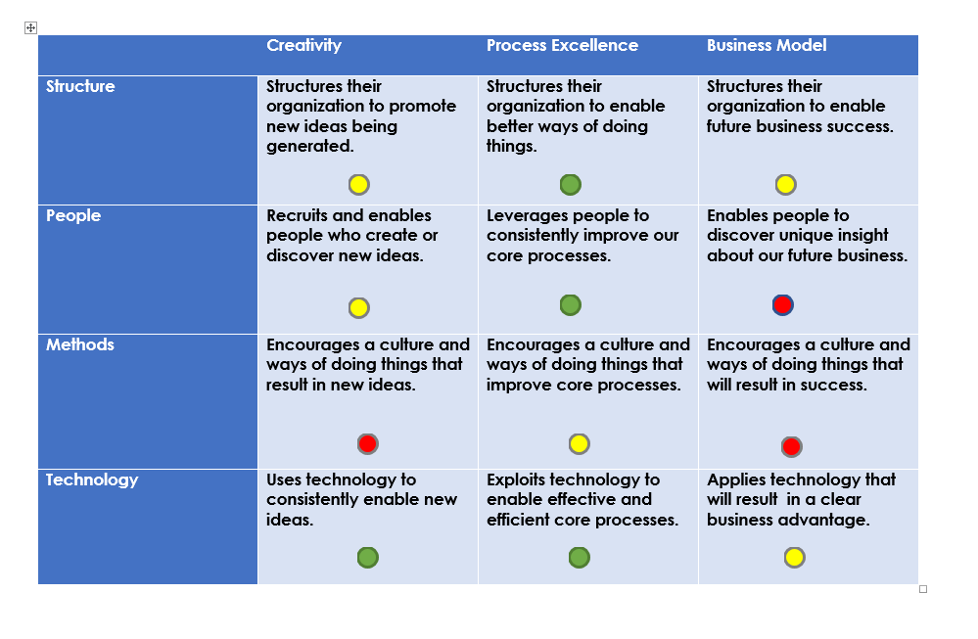
How prepared are our Leaders for Innovation?

Slide 10
Levers That Change Organizations
Structure
Organization Design
People
Select
Methods
Processes
Tech
IT Infrastructure
Hire
Develop
Procedures
Culture
Social Media
Production Technology
Locations
Built Environment
Retain
Engage

Slide 11
Five Innovation Questions: Flawless Execution
“Who has a stake?”
“What could we do differently?”
“Where has this worked before?”
“How will we do it?”
“Why is this important?”

Slide 12
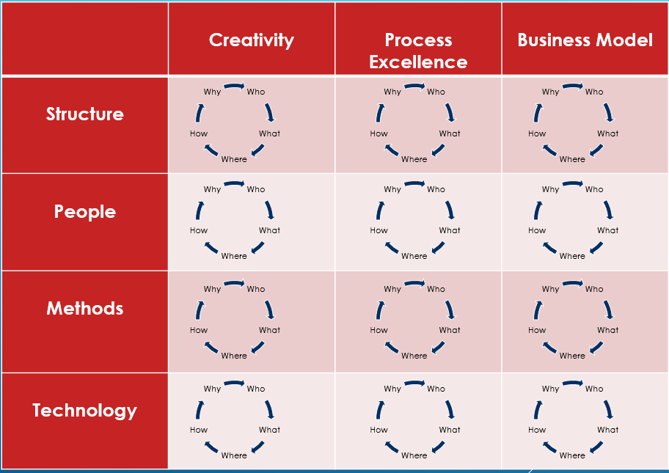
Innovation Strategy Map: Putting it Together

Slide 13
10 Days that Make a Difference
Level 1
(1 Day)
Reviews Organization Innovation Assessment (I-12)
Less than one day in length/Senior Audience
Level 2
(2 Days)
Builds on Day 1, adds Innovation Planning and Leadership Assessment (L-12) of participants
Two more days in length/Senior and Top Tier Positions
Level 3
(7 Days)
Builds on Levels 1 and 2, uses 4-6 Innovation Challenges as platform for change
Seven more days in length/30 High Potentials plus above
Investment: $15,000
Investment: $30,000
Investment: $15,000 per participant
ROI: Strategic View of Innovation and Leadership Readiness
ROI: Innovation Profile
ROI: >$1,000,000 per five participants
+
+

Slide 14
Why the I|L Intensive Works
Fact-based
  Based on your actual organization performance data
Connected to the Business
  Uses your strategy as the lever for change
Changes Leadership Behavior to Achieve Desired Strategy
  Intensive coaching and assessment
Immediate Outcomes
  Focus on current challenges creates urgency
Sustainable Results
  Applies systems thinking and personal inquiry for lasting change

Slide 15
Some Recent Participants Said…
“Amazing ROI. I’m a believer.”
-CFO
“The I-12 is a fantastic tool. Now I know exactly where we need to change.”
-VP, Operations”
“This is free development…I will always do it”
-Global CEO/Board Chair
“What an opportunity to understand the business!”
-Production Supervisor
“Can I come back again?”
VP, Planning
“My career has new direction”
-Director, HR
“We got immediate results!”
-IT Director

Slide 16

…Thank you

